Slide 1
Electrical Circuits

Slide 2
Charges & Current

Slide 3
Learning Intentions
Understand static electricity.
Recall that electric charge can be positive or negative.
Recall that electric current is carried by discrete electric charge carriers.
Recall the law of conservation of electric charge.
Recall that electrical conductors have discrete electric charge carriers that are free to move.
Distinguish between conductors and insulators.
Explain how metals, insulators and semiconductors have different levels of conductivity.
Draw a circuit diagram.
Symbolise components of circuits.

Slide 4
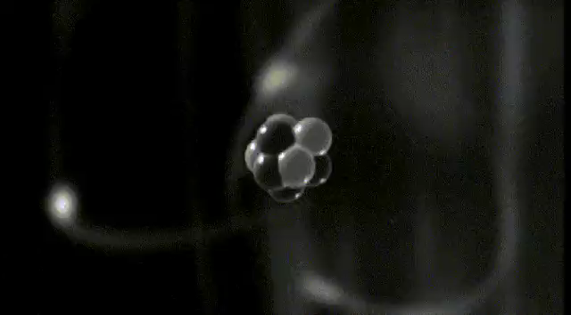
Atoms
To understand how static electricity works, we need to know about charged particles.
Everything around you is made of atoms. Atoms are made up of three types of particle: protons, electrons and neutrons.

Slide 5
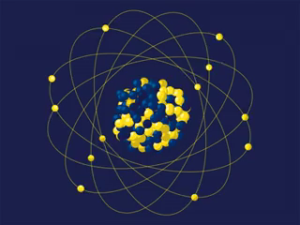
Charged particles
The centre of an atom is called the nucleus.
Protons and neutrons hang out together in the centre (nucleus) of the atom.
Neutrons don't have any charge, but each proton has a positive charge. We represent it with a plus sign.

Slide 6
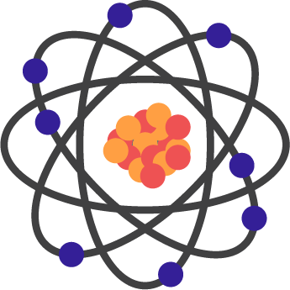
Electrons
The electrons move in orbits around the outside of the atom.
Electrons are negatively charged. This means they have the opposite charge to protons.
In its normal state, an atom has equal numbers of electrons and protons.

Slide 7
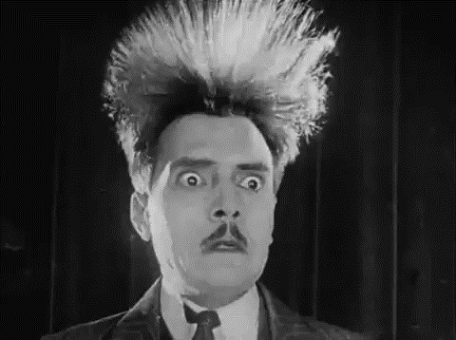
Static Electricity
Static electricity is all about charged particles!
Static electricity is created when charged particles build up on an object and give it an overall positive or negative charge.

Slide 8
Electrostatic forces
Static electricity builds up when objects become either negatively or positively charged.
Opposite charges attract each other through the electrostatic force!
For instance, when you rub a balloon against your hair, it becomes negatively charged and will stick to your hair, which is now positively charged! Electrons have moved from your hair to the balloon.

Slide 9
Same Charges
Objects with the same charge repel each other through the electrostatic force.
Two positively charged objects will push each other apart.

Slide 10
Electric Charges
Electric charge is defined as a physical property of an object that causes it to experience a force when placed in an electromagnetic field.
Electric charge can be either positive or negative.

Slide 11
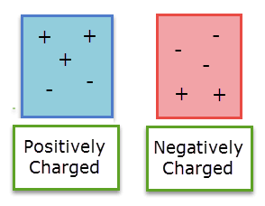
Objects are made up of positive and negative charges, which at the particle level are respectively protons and electrons.
A neutral object has a charge value of zero, as it has an equal number of positive and negative charges.
If an object has more positive charges than negative charges, it is positive. If it has more negative charges than positive charges, it is negative.

Slide 12



When do charges attract and when do they repel each other?
Opposite charges will attract one another.
Like charges will repel one another.

Slide 13
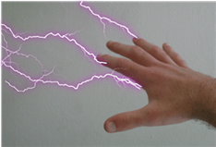
Electricity
Electrical energy is a form of energy that is easy to create and transfer to make new forms of energy.
This energy is created by movement of charge. Protons do not move easily since they are trapped in the nucleus, so electron movement creates electricity.
The electrons must be unbound from their atoms to move, so systems with many delocalised electrons tend to be good conductors of electricity. Metals are an example of a good conductor, because their electrons are relatively free to move around.

Slide 14
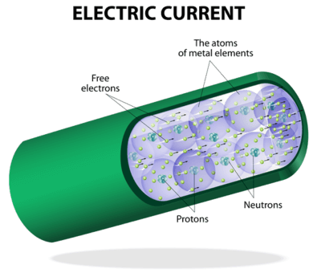
Conductors
A material which allows discrete electric charge carriers, such as electrons, to move through it easily is a conductor. They have a large number of free (delocalised) electrons or ions.
Electric charge carriers in a conductor will move when they have a large potential energy. The movement of electrons is called a current.
Examples of good conductors are copper, gold, and graphite. Worse conductors are water, sugar, and the human body.

Slide 15
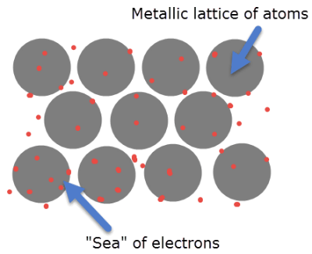
Metals are good conductors
This is because their atomic metal lattice structure unbinds the outer electron shells of the metal atoms. Metals are a lattice of positive ions surrounded by a 'sea' of electrons. This makes them very good at carrying an electron current.
At higher temperatures, metals become worse conductors as the ions and electrons become more energetic and move more. This makes them collide more often and so current can't flow as well.

Slide 16
Insulators
Insulators are materials that do not let a current flow, due to their lack of free electric charge carriers.
They are made up of atoms trapped in ionic or covalent bonds where the electrons are strongly held in bonding pairs. This makes it difficult to create a current because there are no free electrons or ions available.
Examples of insulators are glass, rubber and dry air.

Slide 17
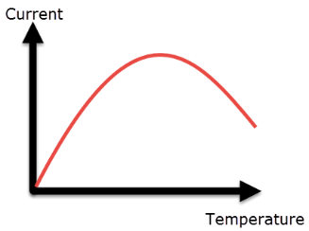
Semiconductors
Semiconductors are materials with very low amounts of free electrons at room temperature, but which gain more as temperature increases.
They have similar structures to insulators, but the bonding electrons are held less strongly.
At too high a temperature, however, the same effect as in metals occurs. This means that at too hot or too cold a temperature they will become poor conductors, but there is a peak in the middle where they become excellent conductors.
Examples of semiconductors include silicon, germanium and gallium.

Slide 18
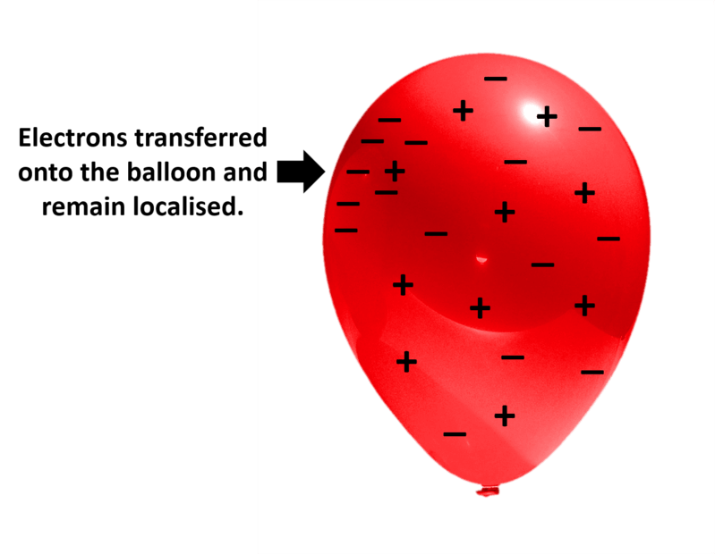
Electrons transferred to an insulator
If electrons are added to an object, they will repel each other and spread out. In an insulator, they are unable to spread out and the negative charge will remain in one place.

Slide 19
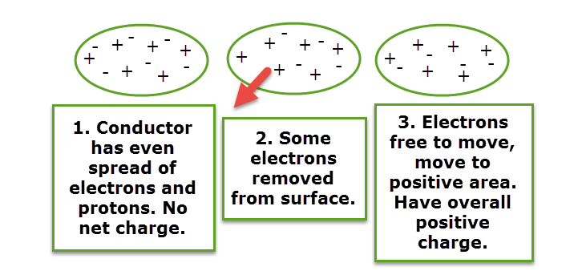
Electrons transferred to a conductor
In a conductor, the electrons will easily spread across the object's surface to create an even distribution. If electrons are removed then the positive charge attracts electrons from other atoms, again evenly distributing the charge.

Slide 20
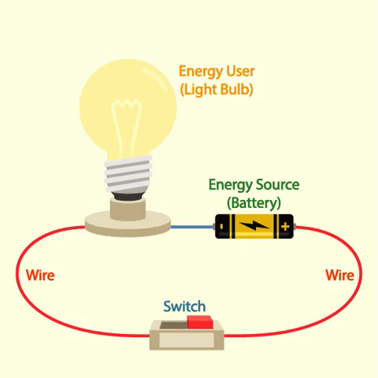
Circuit Introduction
A circuit is a loop of wire which connects an energy source to an energy user.
The energy source is usually a battery. However, it could also be a generator.
The energy user is an object that needs the energy from the energy source. Some common energy users are light bulbs, heating elements and motors.

Slide 21
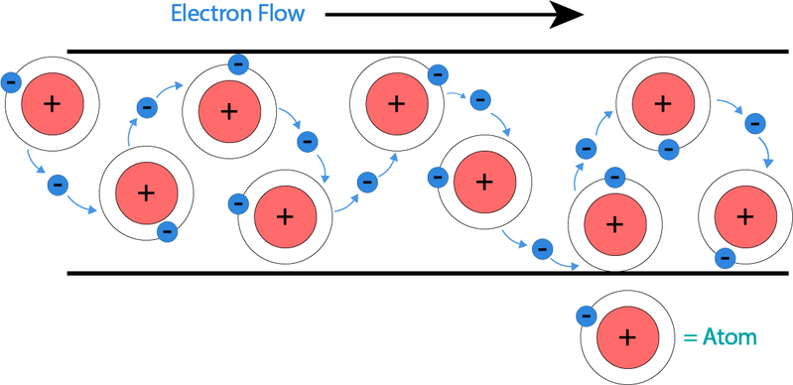
Electron flow in a circuit
The components of every circuit are joined by wires.
We need to use wires in circuits so that electrons can flow between circuit components.
These moving electrons transfer energy from the energy source to the energy user.

Slide 22
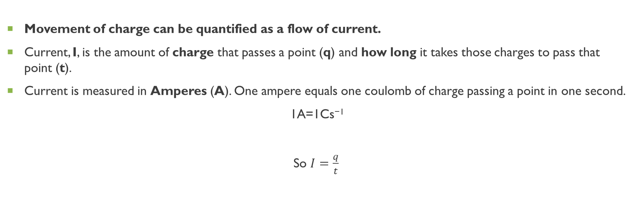
Current
Movement of charge can be quantified as a flow of current.
Current, I, is the amount of charge that passes a point (q) and how long it takes those charges to pass that point (t).
Current is measured in Amperes (A). One ampere equals one coulomb of charge passing a point in one second.
1A=1Cs⁻¹
So $I=\frac{q}{t}​$

Slide 23
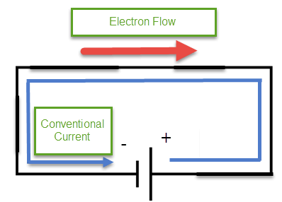
Conventional Current
Up to this point, we have discussed current as the flow of electrons because it is their movement that actually creates a current in a wire.
However the original convention of current was that electricity was the flow of positive charge, this is called conventional current. This is the prevailing way that circuits continue to be taught and discussed, despite that positive charges cannot move in circuits.
Under conventional current, circuit potential goes from highest at the positive battery terminal to lowest at the negative terminal.
Current flows from positive to negative, against the flow of electrons.

Slide 24
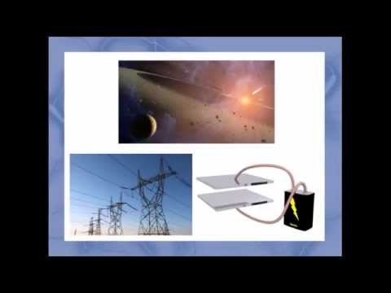
Potential DiffereNce

Slide 25
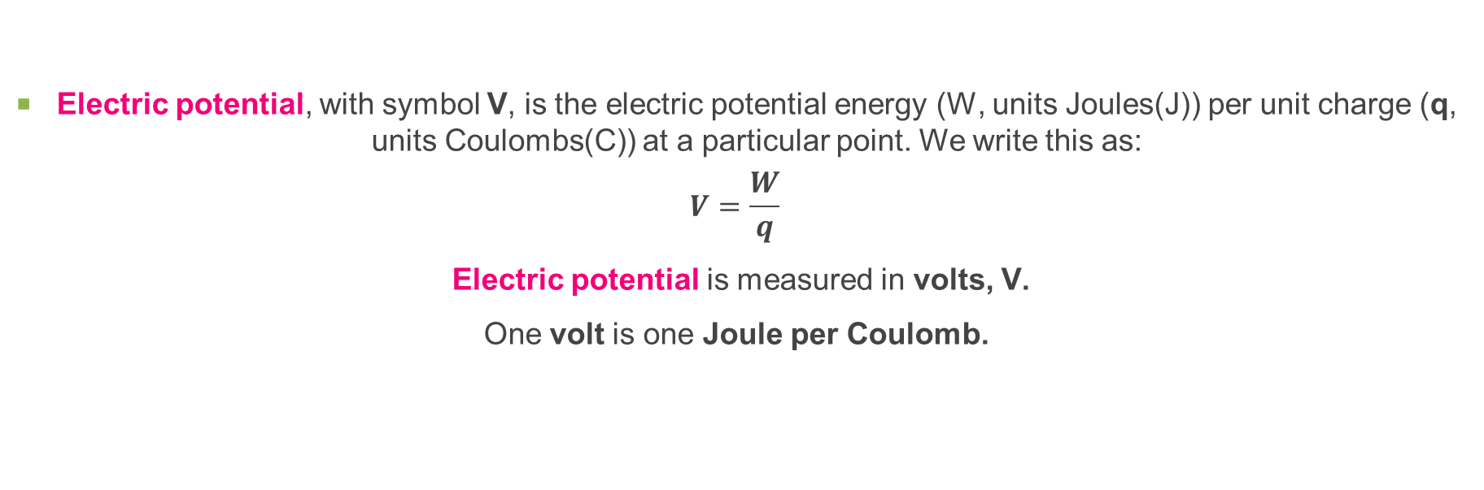
Potential difference calculations
Electric potential, with symbol V, is the electric potential energy (W, units Joules(J)) per unit charge (q, units Coulombs(C)) at a particular point. We write this as:
$$V=\frac{W}{q}​$$
Electric potential is measured in volts, V.
One volt is one Joule per Coulomb.

Slide 26
We measure potential at a point relative to a reference point, so often we are measuring not the potential but the potential difference.
This is the difference in potential energy per unit charge between two points. Potential difference has the same symbol, V, and is referred to as "Voltage".
When a charge q moves between points it will have a change in potential energy. This gain/loss is equal to W=qV.
We measure potential difference with a voltmeter by connecting it to two different parts of a circuit, and it gives us the potential difference between those two parts.

Slide 27
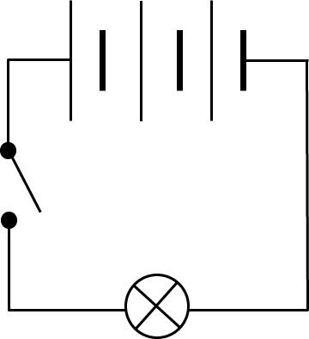
Circuit Diagrams
We can represent circuits and their components with circuit diagrams.
There are a few important circuit components that you need to know the symbols for.

Slide 28
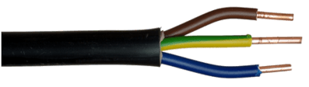
Wire
Processing...
Home
Invite a teacher
It is represented by a straight line.
When you draw a circuit diagram, you must make sure that the circuit components are connected by a wire.

Slide 29
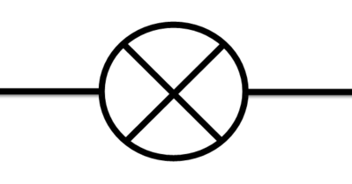
Light Bulb
Light bulbs and LED lights are very common circuit components.
Light bulbs are represented by a circle with an X through the middle. Notice how straight lines on either side of the light bulb represent the wires connecting it to the rest of the circuit.

Slide 30
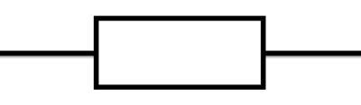

Resistor
We try to keep the symbols for circuit components as simple as possible to make drawings clear.
A resistor is an object which resists the flow of electrons.
It can be represented by either a box or a zigzag line.

Slide 31
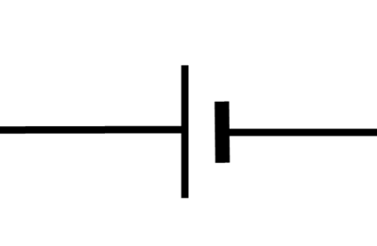
Cell
A cell is a type of energy source.
It is represented by two lines, one of which is longer than the other. The longer side is the positive terminal (+) and the shorter side is the negative terminal (−).

Slide 32
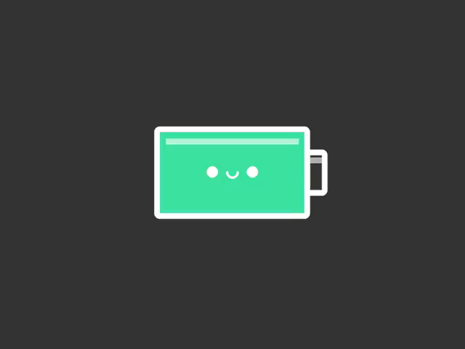

Battery
A battery is made out of several cells which are joined together.
A battery may be drawn as shown below, or it could be represented by a two cells connected by a dotted line.

Slide 33
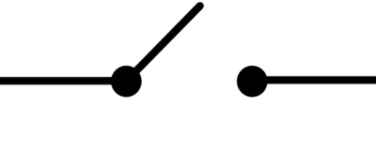
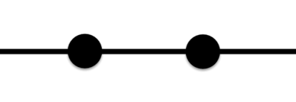
Switches
Many household circuits have switches.
When a switch is closed, it allows electrons to flow across it. Electrons are not able to flow across an open switch because the circuit is broken.

Slide 34
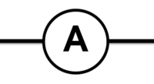
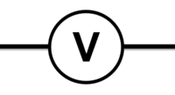
Ammeters and Voltmeters
The final circuit component symbols which you need to know about are ammeters and voltmeters.
Ammeters measure the current flowing through a circuit. Ammeters are represented by a circle with an "A" in the middle.
Voltmeters measure the voltage supplied to a circuit. Voltmeters are represented by a circle with a "V" in the middle.

Slide 35
Power & Ohmic/Non-ohmic Resistance

Slide 36
Learning Intentions
Define resistance.
Explain what resistance is.
Describe how resistance is affected by the length, width and materials of wire.
Recall the meaning of resistivity.
Describe the relationships between current, voltage and resistance.
Explain what Ohm's Law is.
Demonstrate how to rearrange Ohm's Law equation.
Compare ohmic and non-ohmic resistors.
Define power.
Solve problems involving power.

Slide 37
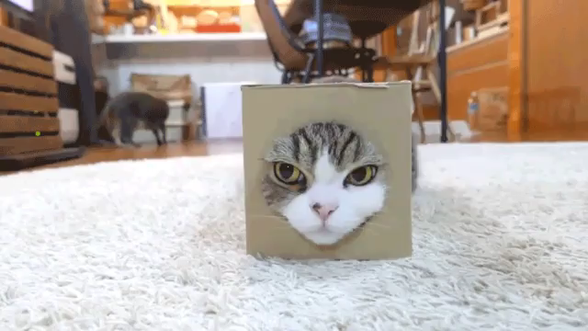
Resistance
Resistance is how much a component opposes the flow of current through it. It causes the electrons to bump into each other.

Slide 38
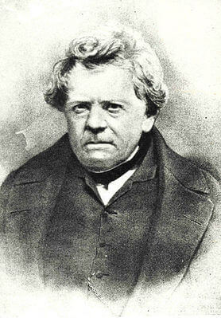
Ohms
Electrons travelling around a circuit will encounter resistance.
Resistance has the unit ohm (Ω). It was named after the important physicist Georg Ohm.
If a component has a high resistance, it has more ohms.
If it has a low resistance, it has less ohms.

Slide 39
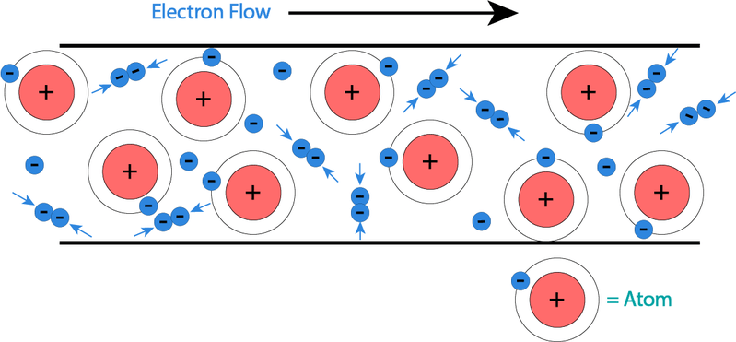
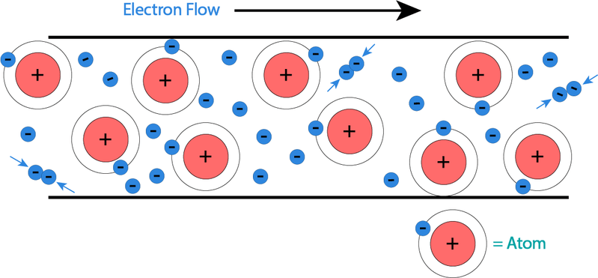
High and Low Resistance
If a component has a high resistance, it is hard for the current to flow through it.
This is because the electrons bump into each other lots as they flow through the component.
If a component has a low resistance, it is easier for the current to flow through the component.
This is because the electrons bump into each other less.

Slide 40
Voltage Drop
Every time electrons bump into each other, they lose a little bit of energy.
This results in a loss of energy as the current flows through a circuit component. This energy loss is known as voltage drop.
A component with a high resistance has a large voltage drop.
This means that it loses lots of energy.
There is a small voltage drop across a component with a low resistance.
This component loses less energy than a component with high resistance.

Slide 41
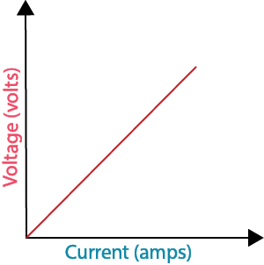
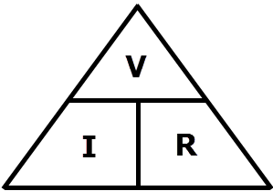
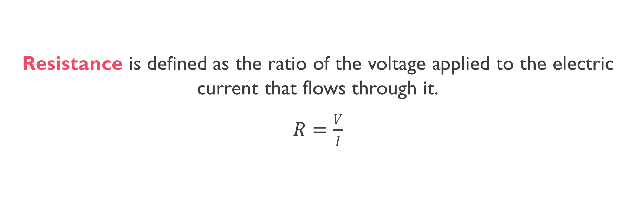
Resistance Defined
Resistance is defined as the ratio of the voltage applied to the electric current that flows through it.
$R=\frac{V}{I}$​

Slide 42
What affects resistance?
The value of resistance (R) is affected by the size of the wire and the amount by which the wire's material resists the current (called resistivity).

Slide 43
Resistivity
Some materials are able to resist movement of charge more than others.
Resistivity (ρ) refers to how much a material opposes the flow of charge.
A table of some common materials and their resistivities is below:
Resistivity depends on temperature - metal resistivity is proportional to temperature, while semiconductor resistivity is inversely proportional. All the resisitivity values were taken at room temperature.
Material | Resistivity (Ωm)
Copper | 1.7×10−8
Nichrome | 1.1×10−6
Graphite | 5.0×10−5
Porcelain | 3.0×1012
Silicon | 0.1−6.0
Germanium | 0.001−0.5

Slide 44
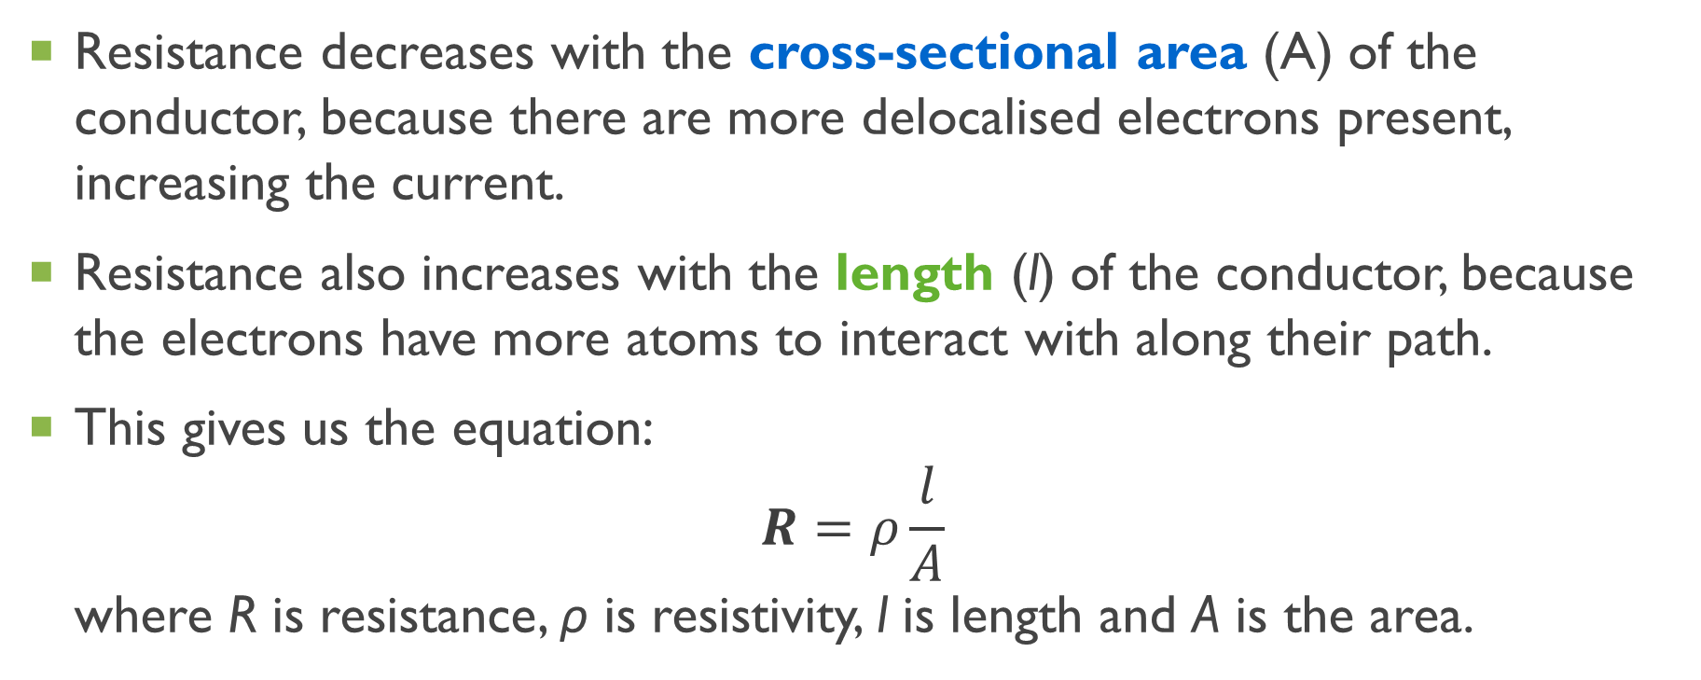
Finding the resistance
Resistance decreases with the cross-sectional area (A) of the conductor, because there are more delocalised electrons present, increasing the current.
Resistance also increases with the length (l) of the conductor, because the electrons have more atoms to interact with along their path.
This gives us the equation: $R=ρ\frac{l}{A}​$ where R is resistance, ρ is resistivity, l is length and A is the area.

Slide 45
Ohm’s Law
Ohm's Law states that the voltage of a circuit is directly proportional to the current of the circuit.
A directly proportional relationship means that changes that happen to one variable will happen to the other.
So what Ohm's Law states is that increasing voltage will increase the current, and decreasing current will decrease the voltage.

Slide 46
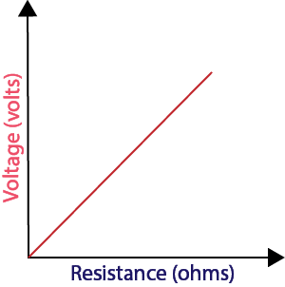
Voltage and resistance
Voltage is also directly proportional to resistance.

Slide 47
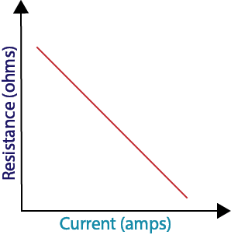
Current and resistance
Current is inversely proportional to resistance.

Slide 48

Ohm’s law Equation
The relationship between current, voltage and resistance can be expressed as:
V=I×R
This means that voltage (V) is equal to current (I) multiplied by resistance (R). It is the most important formula in the study of electricity!

Slide 49
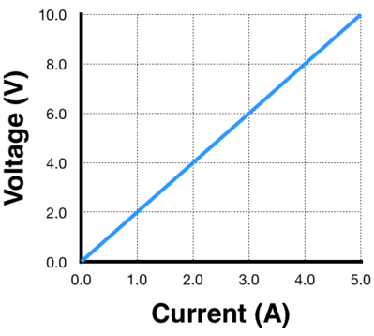
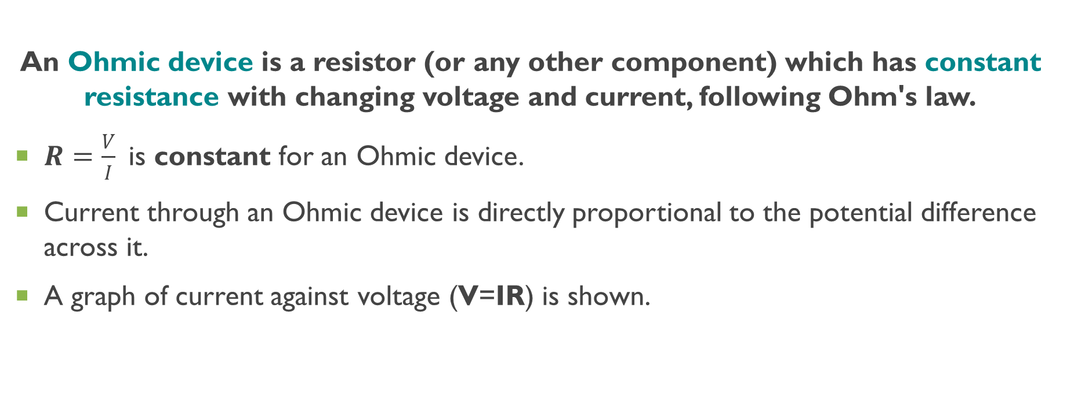
Ohmic device
An Ohmic device is a resistor (or any other component) which has constant resistance with changing voltage and current, following Ohm's law.
$R=\frac{V}{I}​$ is constant for an Ohmic device.
Current through an Ohmic device is directly proportional to the potential difference across it.
A graph of current against voltage (V=IR) is shown.

Slide 50
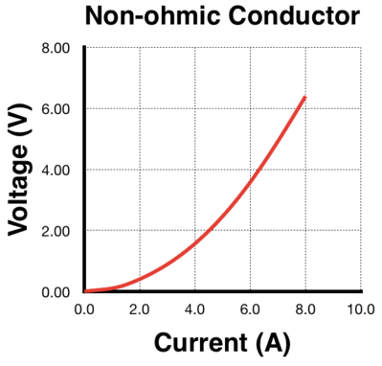
Non-ohmic device
These components have changing resistance values as the voltage and current change. A example of a non-ohmic relationship is in the graph below.
We can see that as the voltage and current increase, the resistance (gradient) also increases. At any single point on the graph V=IR still applies, but it does not describe the trend of the resistance.
Light globes, diodes, LEDs, and other such components are all non-ohmic and commonly used in circuits.

Slide 51
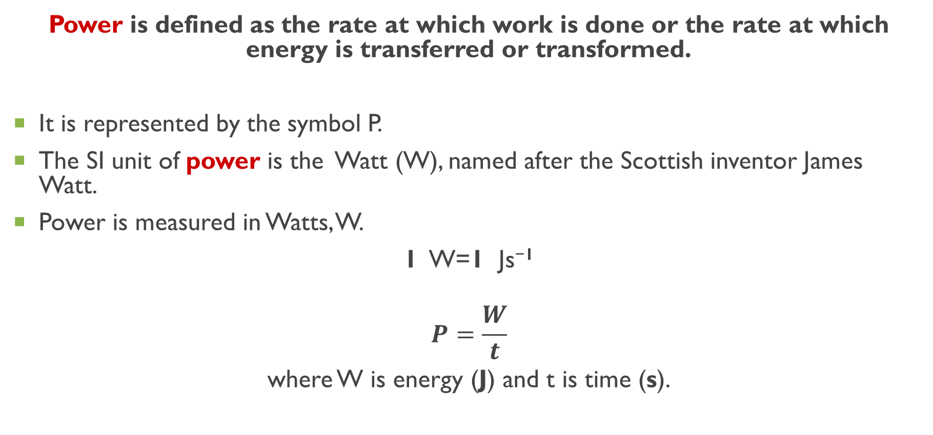
Power
Power is defined as the rate at which work is done or the rate at which energy is transferred or transformed.
It is represented by the symbol P.
The SI unit of power is the Watt (W), named after the Scottish inventor James Watt.
Power is measured in Watts, W.
1 W=1 Js⁻¹
$$P=\frac{W}{t}$$
where W is energy (J) and t is time (s).

Slide 52
Converting energy values to kilowatt-hours
Watts and joules are too small for application to domestic energy use.
A kilowatt-hour is the energy used by a 1 kW appliance in 1 hour.
E(kWh)=P(kW)×t(h)
You can use this conversion to compare energy use of your household appliances in kWh.

Slide 53
Parallel & Series circuits

Slide 54
Learning Intentions
Distinguish between series and parallel circuits.
Explain Kirchhoff's current law.
Explain Kirchhoff's energy (voltage) law.
Recall what a combination circuit is.
Identify Thévenin's Theorem.
Explain the use of voltage dividers.
Solve resistance calculations in parallel and series circuits.

Slide 55
Series circuit
A series circuit forms a single loop. All of the components are in a line.

Slide 56
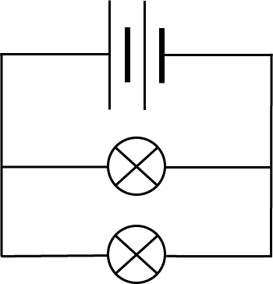
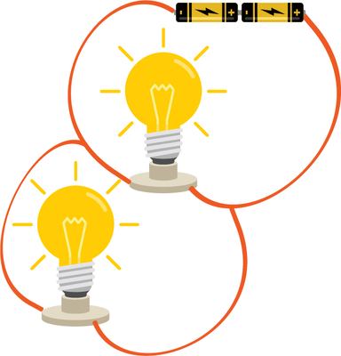
Parallel Circuit
A parallel circuit has multiple branches. Each branch has circuit components on it.

Slide 57
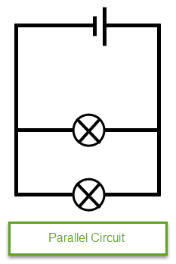
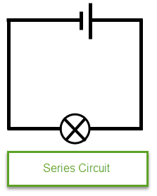
Series and parallel circuits
In a series circuit, charged particles have only one pathway to travel through. Charges flow at the same speed across the circuit and do not leave as charge is conserved. Thus current is the same throughout the circuit.
Parallel circuits have multiple pathways for charged particles to travel through.
At a junction of three or more pathways the charges can travel in any direction, but the total number of charges arriving at a junction each second must be the same as the total number leaving the junction each second.

Slide 58
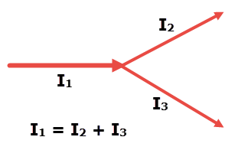
Kirchhoff’s current law
In circuits, charge is conserved as particles travel through the wires.
We know that the same number of charged particles leave a junction as do enter them.
It states that the sum of all currents entering a junction is the same as the sum of all currents leaving that junction.
ΣI_{in}​ = ΣI_{out}​, or I_{1​} = I₂​ + I₃​

Slide 59
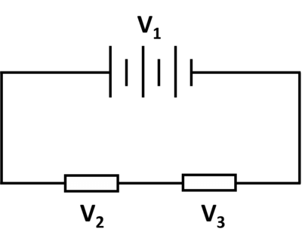
Kirchhoff’s energy (or Voltage) law
Kirchhoff's Energy (or Voltage) Law states that the total potential difference around a closed circuit is 0. Therefore the potential must be used by each load in the circuit.
V_{1​}=V₂​+V₃
where V₁​ is the voltage provided by the battery. The value of voltage across a load depends on the energy it uses, so different components often have different voltages.

Slide 60
Kirchhoff’s energy (or voltage) law
In parallel circuits, the same principle applies. A parallel section is treated as a single component and has one voltage across it which is equally applied to each branch.
V₁​=V₂​=V₃
For example, the circuit on the right has a 12 V battery. This provides 12 V of potential to each lamp.

Slide 61
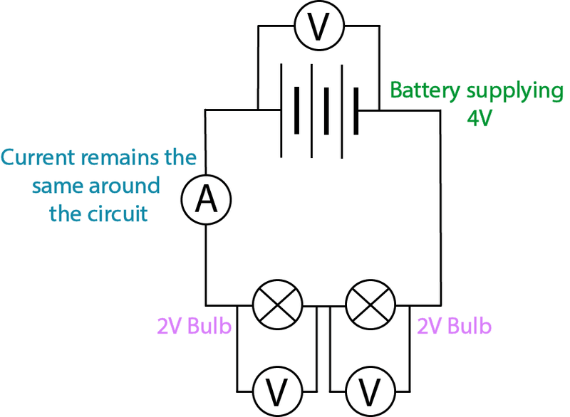
Voltage and Current in Series Circuit
In series circuits, each component has the same current through them. This is because there is only one path for the current to flow along.
However, voltage is split up in series circuits. The voltage across each component depends on the resistance of the component.

Slide 62
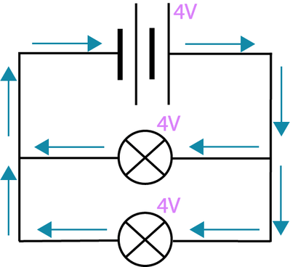
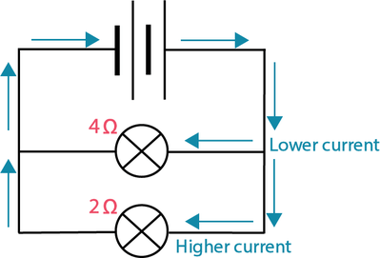
Voltage and current In parallel circuit
Branches in parallel circuits have the same voltage across them.
However, the current is split up in these circuits. This is because there are multiple paths for the current to flow down, but each electron can only go down one branch at a time.

Slide 63

Simplifying resistance
Whether multiple resistors are in series or parallel with each other affects how we do calculations with them. The total or combined resistance (R_{T}​) of two or more individual resistors can be found by using the formulae in the table below.

Slide 64

Combination circuit
When all components are connected in series, the circuit is described as a series circuit.
When all components are connected in parallel, the circuit is described as a parallel circuit.
When you have both components connected in series and in parallel, the circuit is described as a combination circuit. The more components you have, the more connections there are between them, and the more complex the circuit becomes.

Slide 65

Thévenin's Theorem
Thévenin's Theorem states that any DC (Direct Current) circuit, no matter how many power sources or loads it contains, can be reduced to a simple equivalent circuit. This equivalent circuit contains one source and one load, which have the combined effects of all the sources and loads in the real circuit.
Basically, the theory says that this can be re-drawn like this...

Slide 66


Using Thévenin's Theorem
Using Ohm's Law and Thévenin's Theorem it is possible to derive this equation:
$$\frac{V_{out}}{V_{in}}=\frac{R_{2}}{R_{1}+R_{2}}$$
All this says is that the ratio of voltages is the same as the ratio of R₂​ to the total resistance (R₁​+R₂​). R₂​ always refers to the resistor that the output voltage is measured across.

Slide 67


Thévenin's Example
In our example, R₁​ is the blue resistor and R_{2​} is the red resistor, across which we measure the reduced output voltage (V_{out}​). Below is an example calculation to show you how we got the output value of 1.2 V:

Slide 68
Components & Safety

Slide 69
Learning Intentions
Recall the use of semiconductors in electronic components such as diodes.
Explain the basic functions of diodes, variable resistors and transducers.
Explain the purpose of short circuits, and fuses.

Slide 70

Diodes
A diode contains semiconducting material, like silicon or germanium, that changes its properties depending on which way current flows.
In particular, the resistance of a diode can be next to zero when connected the proper way, or practically infinite when connected the opposite way. The effect of this is that current can only pass through a diode in one direction.

Slide 71

Circuit symbol-Diode
This is the symbol we use to represent a regular diode on a circuit diagram. The arrowhead shows its preferred orientation in a circuit.
If the diode is connected so that current can flow in the direction of the arrowhead, we say it is forward biased. If it's connected the opposite way, it is reverse biased and current cannot pass through.

Slide 72


Light-emitting diode (LED)
A light-emitting diode (LED) is a very common type of diode that lights up when current passes through it the right way.
They are found in indicator and bicycle lights, in torches and traffic lights, and as efficient substitutes for normal lamps.
This is the circuit symbol for an LED. It looks just like the one for a normal diode, but with an added circle and two arrows to show light being given off.

Slide 73


You have probably seen a red LED before, but they are made with many other colours as well. The reason red ones are so abundant is because they require only a small voltage to work. Red light has the longest wavelength of any colour in the visible spectrum.
It turns out that as the wavelength of light decreases, you need a higher voltage to be able to emit the corresponding colour. This is summarised in the graph, which compares the required voltages for different types of LEDs at different current levels. Notice that all the lines are curved, because LEDs are non-Ohmic conductors.

Slide 74
Types of Resistors
There are also different types of resistor that we can use in circuits.
We’ve considered passive resistors that sit around with a fixed resistance.

Slide 75

Rheostat

Slide 76

Light-dependent resistor
A light-dependent resistor (LDR) is not controlled by a sliding contact. Instead, it is sensitive to changes in light intensity.
The LDR contains a combination of cadmium sulfide (CdS) and cadmium selenide (CdSe), which decrease the component's resistance when light intensity increases. In other words, exposing an LDR to bright light will dramatically improve its ability to conduct electricity.

Slide 77


Thermistor
Its resistance changes in response to a change in temperature - depending on how it's made, the resistance will either increase or decrease.
Thermistors are used in many devices where temperature must be measured or regulated. The most obvious examples are in digital thermometers, and in control circuits of heaters and air conditioners.
Here is the circuit symbol for a thermistor:

Slide 78

Input transducers
An input transducer is a device that produces electricity from some other form of energy. A microphone is a good example of this. When you speak into a microphone, it receives sound energy from you and transforms it into electrical signals.

Slide 79

Output Transducers
An output transducer does the opposite - it takes electrical energy from a circuit and converts it into something else.
For instance, a loudspeaker can receive electrical signals and convert them to sound. We won't worry much about how it does this. What's important is the transformation of energy that takes place!

Slide 80

Alternating Current
The electricity produced by batteries and solar cells is in the form of Direct Current (DC), which means it flows in the same direction all the time.
However, the electricity delivered to your house through power lines is in a different form. It is called Alternating Current (AC), because the direction of current changes (alternates) at a certain rate.
In Australia, the current in power lines alternates 50 times in each second. We say it has a frequency of 50 Hertz, or 50 Hz. There is also an associated voltage, which cycles at the same rate. The electricity supplied to your house has an "average" voltage of 240 V.

Slide 81
Cable
A cable connects your home to the power lines. Inside this cable are two wires coated with insulating material. One of them is called the active wire, while the other is the neutral wire.
The active wire is the one that actually delivers power to your house.
The purpose of the neutral wire is to complete the circuit and let AC flow safely back out of your home. It is connected to the ground (earthed) and has almost the same electric potential as the ground. This is a safety precaution, designed to help prevent shocks.

Slide 82

Power points
Power points like this one are all connected by a big circuit, which is energised by the active wire. You don't see any of the circuit itself, because it's mostly inside the ceiling.

Slide 83


Active/Earth /Neutral
Most appliances connect to power points with a three-pin plug. Inside the plug are three wires as shown in the diagram below. They are the active, neutral and earth wires.
The pins on the plug each have one of these wires attached to them. They are arranged so they match with the corresponding socket in a power point. This diagram shows the connections to the active/neutral wires and earth.

Slide 84

Short circuit
A short circuit can happen when there is a direct (and unwanted) connection between the active and neutral wires of an appliance. This creates a very low-resistance path for current, which will bypass the appliance in question.
Not only does the appliance lose power, but the wires can get very hot and break down. This is because, with low resistance along the path, the current becomes very high. This would damage the appliance, or make it unusable!

Slide 85

Ways to stop short circuits
Here is a model of a typical fuse. There is always a fuse connected to the active wire. It consists of a thin length of copper wire, held in a ceramic carrier. If the current through it becomes too high, the thin wire melts and breaks the circuit.
A circuit breaker does the same job, but in a different way. It contains a small electromagnet that opens a switch when the current becomes too high. When the switch opens, the circuit breaks. It can open in a very short amount of time, which saves the circuit from overheating and melting.

Slide 86

Personal Safety
Do not try to repair an electrical appliance yourself, unless you are qualified.
Never mix electricity and water.
Replace all defective or damaged appliances and cords.
Do not perform experiments on appliances that are switched on.
Stay away from overhead power lines.
Make sure you're up to date on your first aid skills.

